Slide 1


KICAD PROJECT
Ludovic Darguy
Louis-Baptiste Rabillon
5 ISS A2

Slide 2
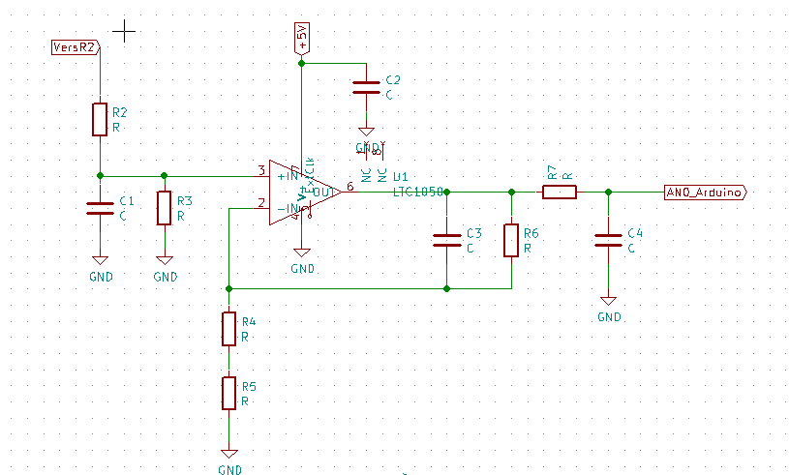
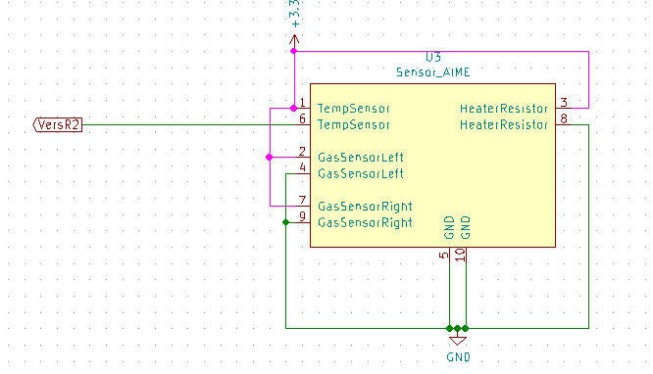
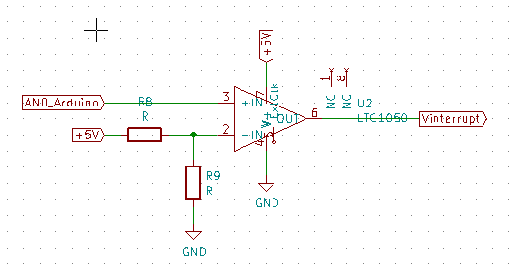
Architecture
Electronics for gas sensor
Gas sensor
Comparator

Slide 3
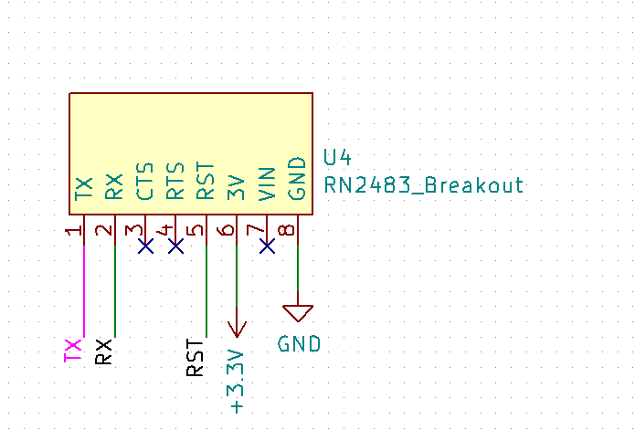
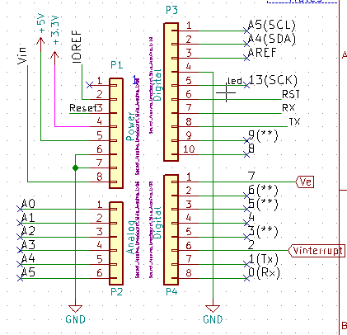
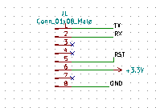
Architecture
LoRa module
Pins to replace LoRa module
Arduino pins

Slide 4
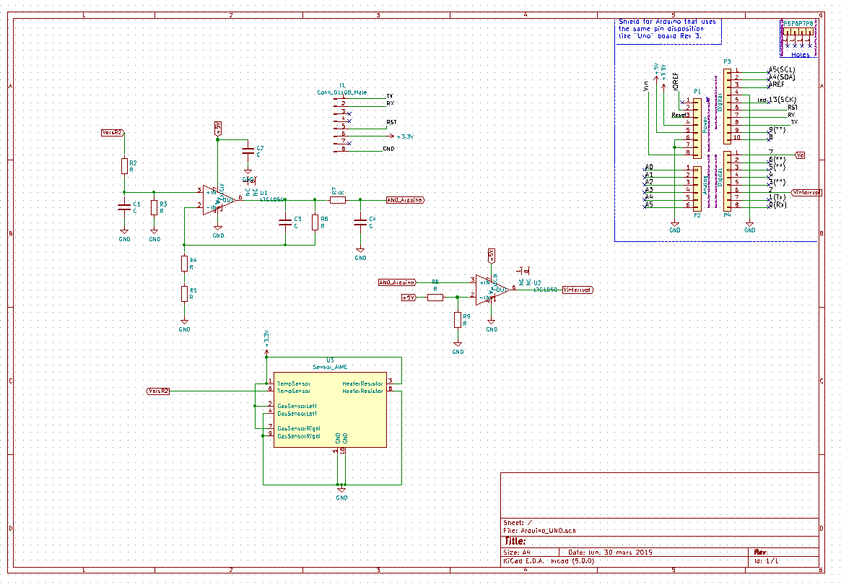
Architecture

Slide 5
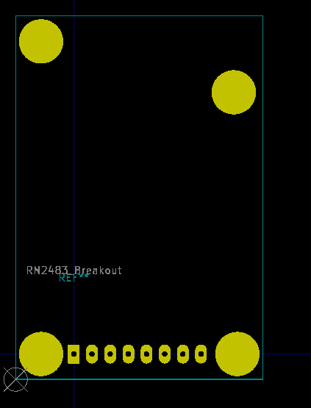
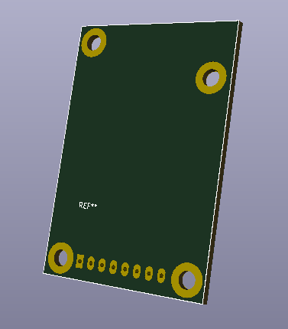
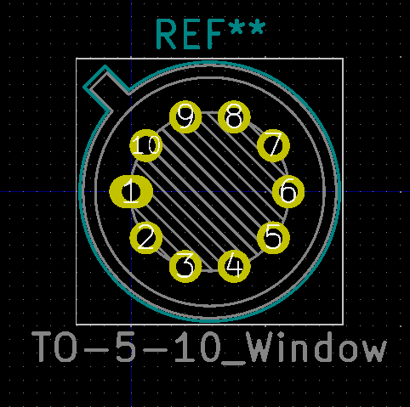
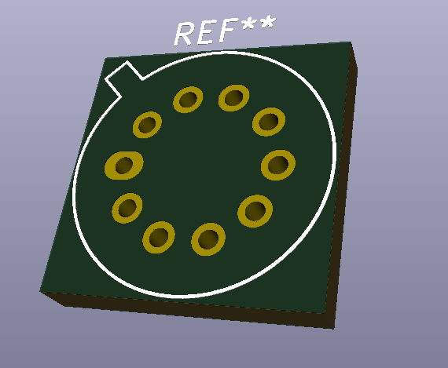
Footprints
RN2488 Breakout
Gas sensor

Slide 6
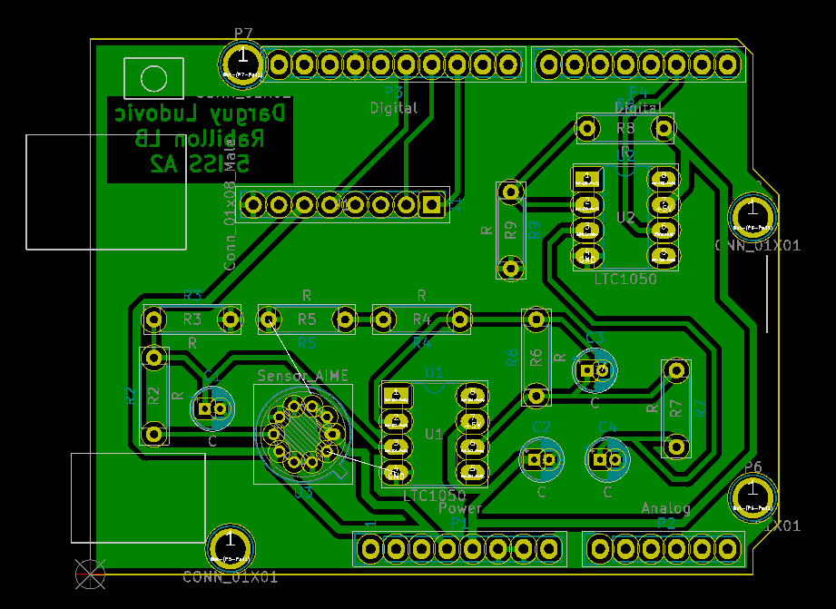
Layout
6mm for signals tracks
8mm for alimentation tracks

Slide 7
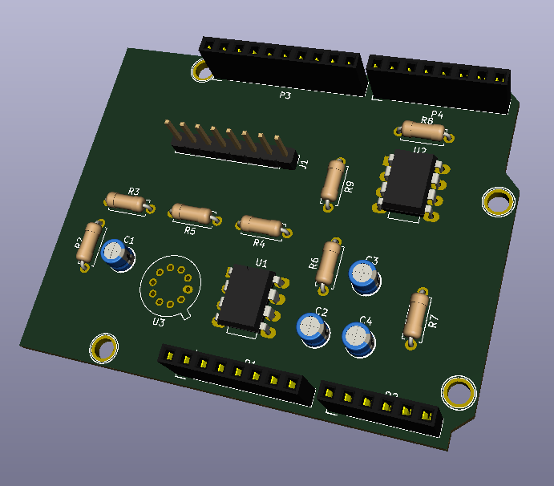
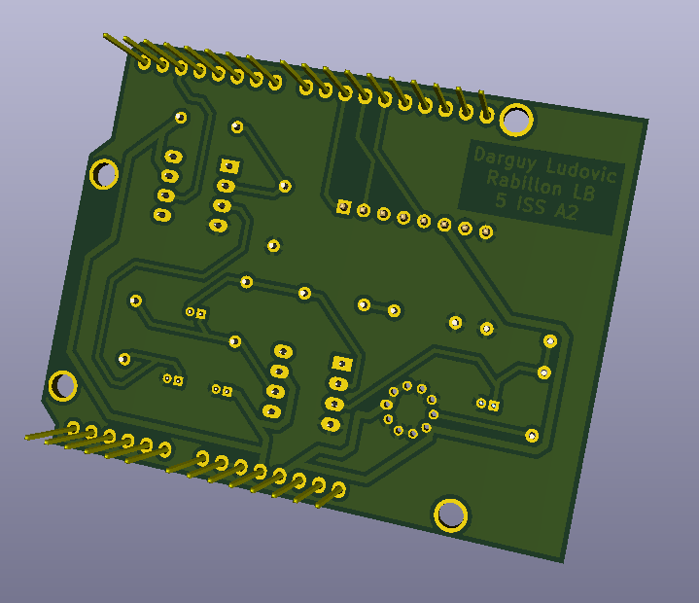
3D rendering
Connectic for LoRa module
Gaz sensor footprint

